Slide 1


AWS DynamoDB Kole Vasilevski, Principal Software Engineer

Slide 2
Serverless application
What is Serverless application?
Serverless is a cloud-native development model that allows developers to build and run applications without having to manage servers.
What is Serverless service in AWS?
No infrastructure
No patch and updates
Fully manage by AWS

Slide 3
DynamoDB
NoSQL database service (schemeless data model)
Support document and key values data model
You can scale up or scale down throughput capacity without downtime or performance degradation
Provides on-demand backup capability
Stored on (SSDs) disks
Automatically replicated across multiple AZs in an AWS region
Tables can be automatically replicated across two or more AWS Regions

Slide 4
DynamoDB Consistency models
Eventually consistent reads
Strongly consistent read

Slide 5
DynamoDB Throughput Management
Read capacity unit
1 strongly consistent read per second, or two eventually consistent reads per second, for an item up to 4 KB
Write capacity unit
1 write per second for an item up to 1 KB in size
Throttling
Prevents your application from consuming too many capacity units

Slide 6
DynamoDB Core Components
Tables
DynamoDB stores data in a table, which is a collection of data
Items
Rows in tables with data
Attributes
Scalar Types (number, string, binary, Boolean, and null) ,
Document Types (complex structure such as JSON document)
Set Types (string set, number set, and binary set)

Slide 7
DynamoDB Primary Key
Partition key
Simple primary key, composed of one attribute.
Partition key and sort key (composite primary key)
Composed of two attributes.

Slide 8
DynamoDB Secondary Indexes
Global secondary index
An index with a partition key and sort key that can be different from those on the table.
Local secondary index
An index that has the same partition key as the table, but a different sort key

Slide 9
DynamoDB Querying
Query
Queries operation locate items or secondary indices through primary keys.
Scan
Scan Operations read all table items or secondary indices.

Slide 10
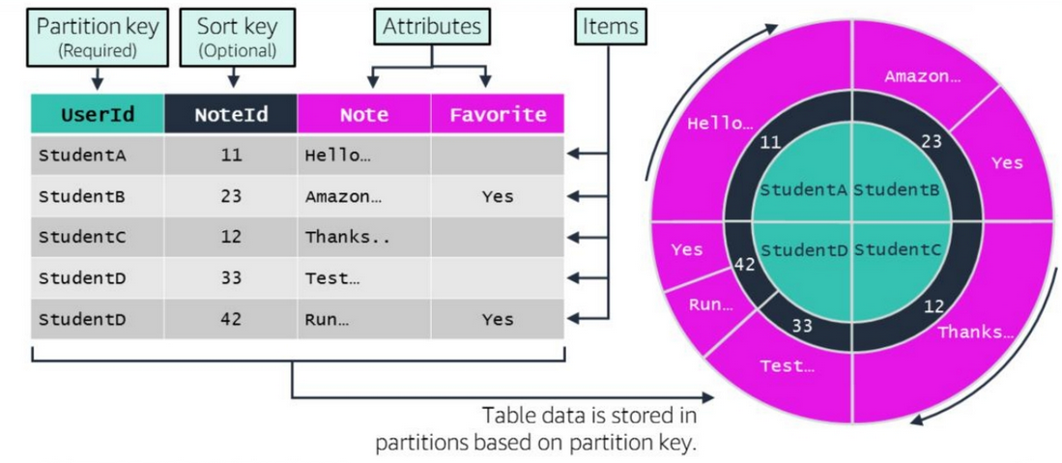
DynamoDB Data Partitioning

Slide 11

DynamoDB Demo in AWS Console

Slide 12

DynamoDB Demo .NET Code

